Slide 1

TRANSORG AGENTIQ
Mandi to Market Optimizer
A comprehensive solution integrating data, analytics, and decision intelligence for the agricultural supply chain.
Team Name : FourByte
Member 1: Ankit Kumar Singh
Reg.no. : 12504384
Member 2: Gnaneshwar Reddy
Reg.no. : 12510404
Member 3: Kota Rohith
Reg.no. : 12516500
Member 4: Santhosh
Reg.no. : 12510312

Slide 2
TRANSORG AGENTIQ
The Problem
India's agricultural supply chain generates data but lacks intelligence, creating challenges for effective decision-making.
  Messy crop names
  Mixed units
  Missing values
  Invalid transit times
  Different timestamps

Slide 3
TRANSORG AGENTIQ
Our Solution
Mandi Intelligence
Transforming messy datasets into actionable insights requires a streamlined process for effective decision-making and analysis.
RAW DATA → CLEANING → SQLITE
→ ANALYTICS → DASHBOARD → AI AGENT

Slide 4
TRANSORG AGENTIQ
Data Trustworthiness
Standardization
Conversion
Validation
Implementing consistent crop name and Mandi ID formats ensures a reliable data foundation for analysis.
Converting measurements like quantity to quintals and distance to kilometers enhances data integrity and usability.
Identifying and excluding invalid records, such as negative transit times, guarantees data quality throughout the pipeline.
57 Mandis 25,000 Arrivals 12,000 Prices 10,000 Trips 15,000 Weather Records

Slide 5
TRANSORG AGENTIQ
Analytics Engine
01
Decision Signals
This analytical layer produces insights for decision-makers, providing multiple signals from cleaned datasets for actionable intelligence.
5,659,184.82 Qtl
3,924
18.68%
Total crop arrivals
Price crash instances
Transport delay rate
02
SQLite Database
342
Utilizing SQLite, the architecture efficiently stores and exposes various analytical views, enhancing data retrieval for stakeholders.
Routes Monitored
03
Clean Architecture
A streamlined structure supports data flow, ensuring that cleaned data effectively feeds into the analytics layer for reliable analysis.

Slide 6
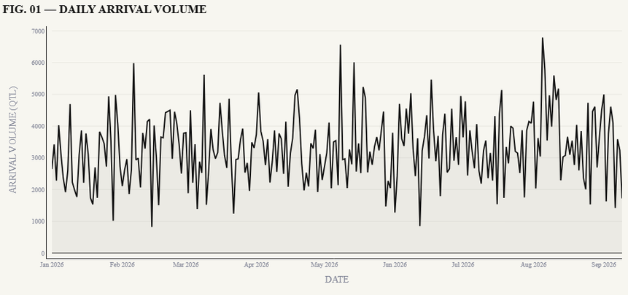
TRANSORG AGENTIQ
Supply Intelligence
TOP 5 MANDIS BY ARRIVAL VOLUME (QTL)
1. South Dumdum Grain Market — 20,539
2. Arrah Mandi — 20,454
3. Gurgaon Grain Market — 18,923
4. Asansol Grain Market — 17,948
5. Hyderabad Mandi — 17,863
CROP-WISE ARRIVAL DISTRIBUTION (QTL)
Mustard 966,396 Wheat 965,396 Sugarcane 949,853
Maize 940,987 Cotton 922,311 Rice 914,242
Source: AgriTech Analytics Database
Ranked by arrival volume and crop-wise distribution, drawn from the cleaned Crop Arrivals dataset. The daily trend excludes the dataset's blank-date aggregate row (4,825,951.80 Qtl).

Slide 7
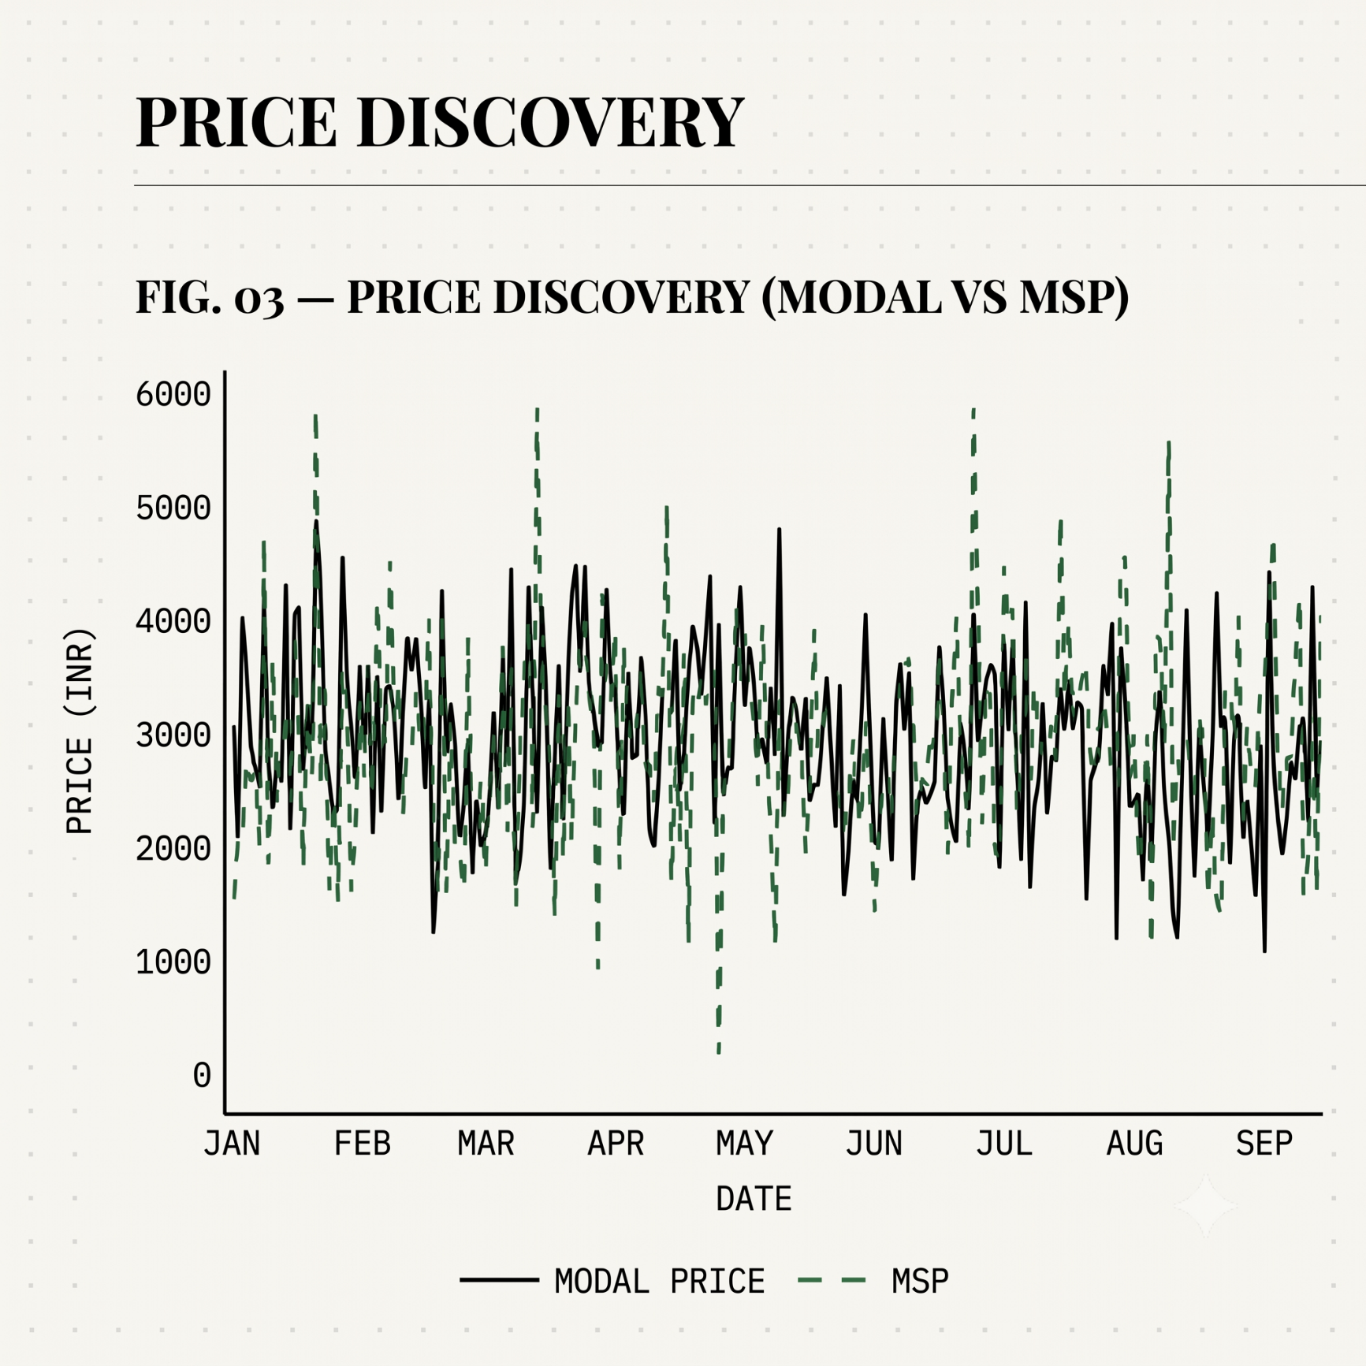
TRANSORG AGENTIQ
Price Discovery
When wholesale price falls below MSP
3,924
Price Crash Instances
Definition: Price crash = Modal Price < MSP. 610 records missing Modal Price. 2,377 records missing MSP. Does not establish why crashes occurred.

Slide 8
TRANSORG AGENTIQ
Logistics Intelligence
Routes Monitored
Delay Methodology
Delay Rate
342 monitored routes. 8,455 valid transit trips. 539 invalid negative transit records excluded from calculations.
A route is flagged delayed when transit time exceeds 1.5x the average valid transit time for that Mandi to Warehouse route.
1,584 delayed trips. 18.68% transport delay rate. Identified delay patterns, not a claim of reduced delays.

Slide 9
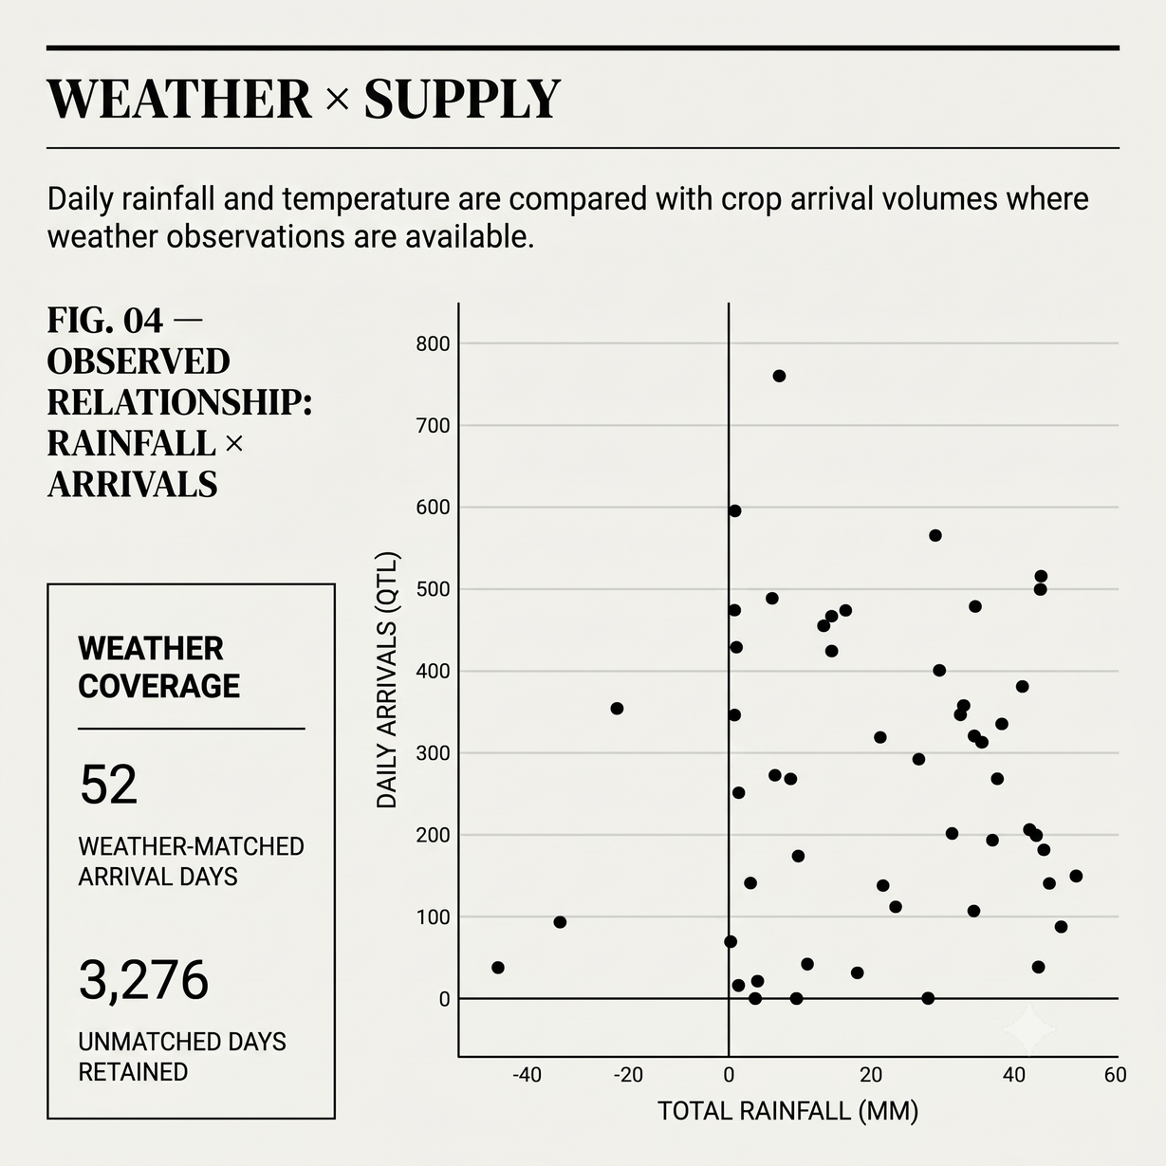
TRANSORG AGENTIQ
Weather × Supply
CURRENT DASHBOARD VIEW
52 weather-matched arrival days
3,276 unmatched days retained with NULL weather metrics
(filtered view — not a global project total)
Observed Relationship
Rainfall vs arrival volume, aggregated to daily grain before joining with arrivals, preventing many-to-many inflation. Not a causal claim.

Slide 10
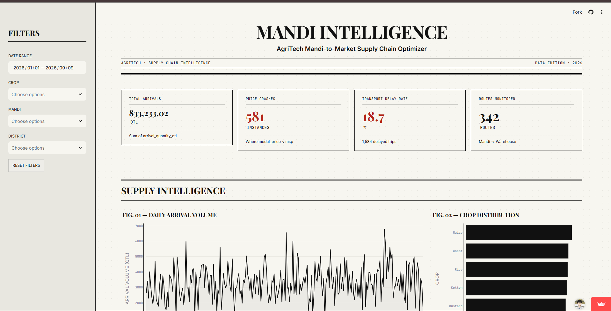
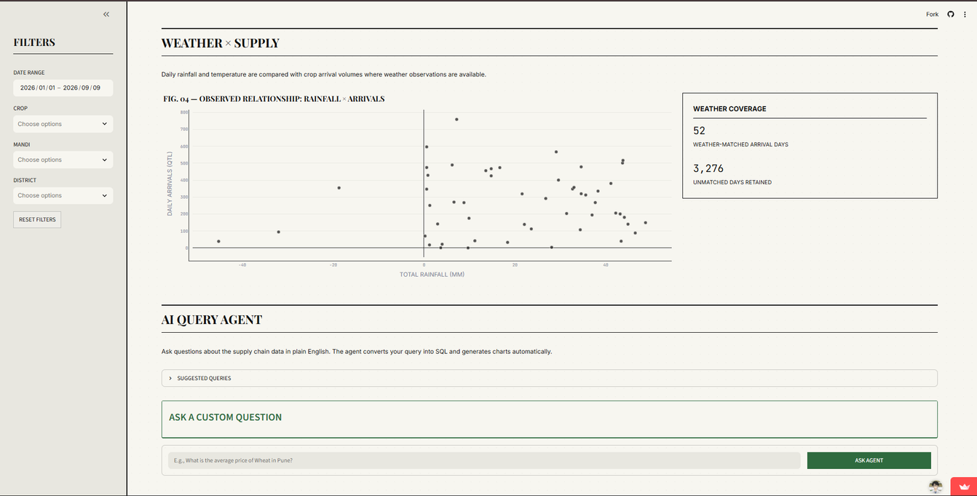
TRANSORG AGENTIQ
Executive Dashboard
One Screen for Mandi to Market Intelligence
This dashboard provides a comprehensive overview of critical agricultural data, integrating supply, pricing, logistics, and weather information for informed decision-making across the supply chain.
Interactive Streamlit dashboard for supply-chain intelligence

Slide 11

TRANSORG AGENTIQ
AI Query Agent
USER QUESTION → AI QUERY AGENT → ANALYTICAL QUERY → DATA-BACKED RESULT → CHART + TEXT SUMMARY
EXAMPLE QUESTIONS
Show Wheat arrivals in Amritsar mandi.
Which mandis have prices below MSP?
What is the highest average transit delay?
Show rainfall by district.
What are the highest-volume warehouses?
Ask the Data Instead of Searching Through Charts
Ask questions about the supply chain data in plain English. The agent converts your query into SQL and generates charts automatically.

Slide 12
TRANSORG AGENTIQ
Technical Architecture
01
Data Pipeline
Raw Datasets
↓
Data Cleaning Pipeline
↓
Clean Dataset
↓
SQLite Analytics Database
↓
Validated SQL Views
↓
Streamlit Dashboard
↓
AI Query Agent
A streamlined data pipeline efficiently connects raw datasets to a clean analytics database for effective decision-making.
02
Reproducibility
The architecture ensures reproducibility, allowing for consistent data cleaning and analytical processing through well-defined Python scripts.
03
Technology Stack
Built using Python, SQLite, and Streamlit, the technology stack supports robust data handling and visualization capabilities.

Slide 13

TRANSORG AGENTIQ
Validation & Reproducibility
DATA QA / VALIDATED
✓ Cleaned row counts reconciled
✓ Duplicate handling verified
✓ Arrival totals reconciled
✓ Weather join checked for many-to-many inflation
✓ Price crash condition manually validated
✓ Invalid transit records excluded from valid calculations
✓ Route delay methodology validated
✓ Analytical views tested against source data
Raw data remains untouched. Cleaning and analytics are reproducible through Python scripts.

Slide 14
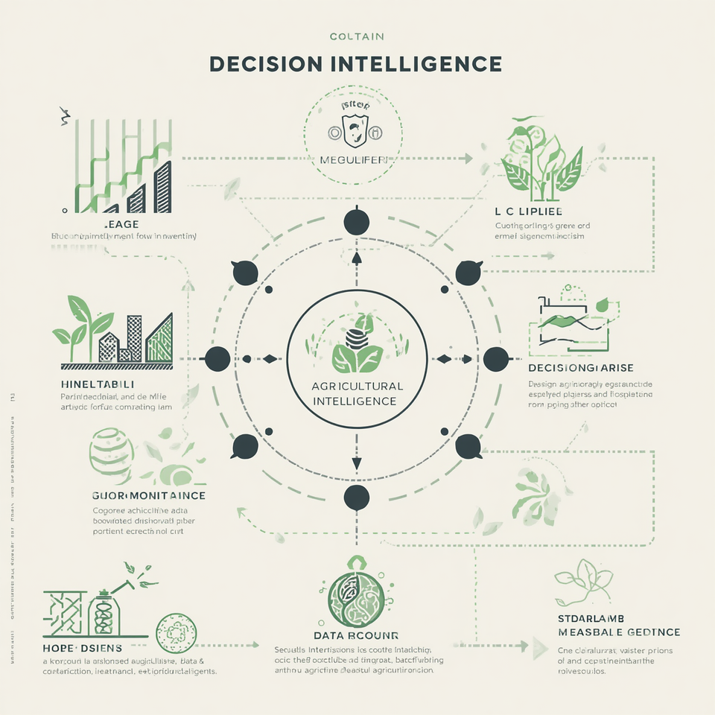
TRANSORG AGENTIQ
Decision Intelligence
SUPPLY — Where are arrivals concentrated?
PRICE — Where is modal price below MSP?
LOGISTICS — Which routes show higher delay frequency?
WEATHER — Where do rainfall patterns coincide with supply changes?
MARKET SIGNALS — What requires attention?

Slide 15

TRANSORG AGENTIQ
Conclusion
AGRITECH INTELLIGENCE
AgriTech transforms fragmented agricultural data into trusted supply-chain intelligence.
Clean Data → Validated Analytics → Interactive Dashboard → AI-Powered Insights
MANDI → SUPPLY → PRICE → LOGISTICS → WEATHER → INTELLIGENCE
GitHub: github.com/httpsankuu/agriTech
Live Dashboard: agritech-byankith.streamlit.app
Python · Pandas · SQLite · SQL · Streamlit · Plotly · Custom CSS

